Slide 1
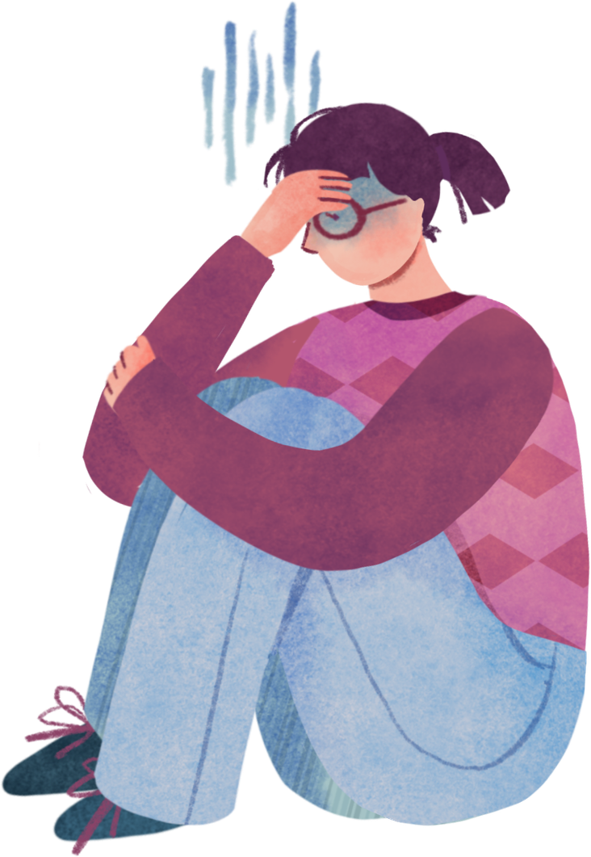


Emotional
well-being
Sleeping, eating and technology habits and their correlation to emotional well-being.
Tuesday, july 14th, 2026.

Slide 2
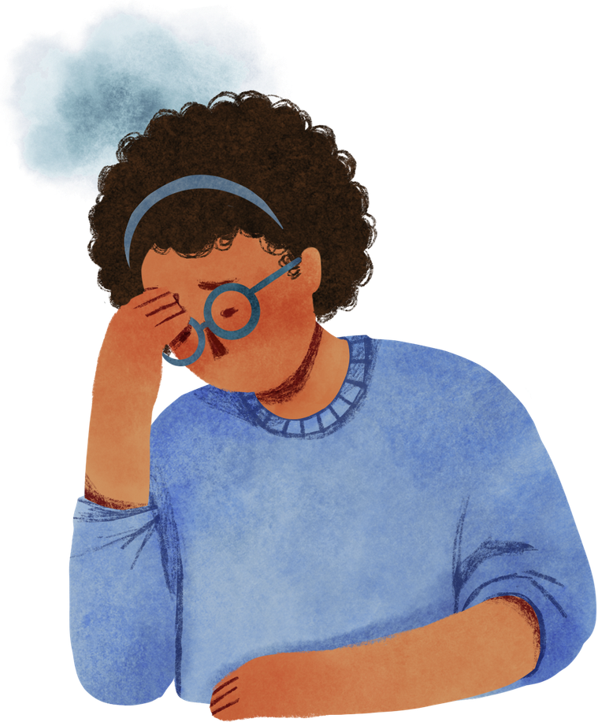
Background
In academic environments, sleep habits, eating patterns, and technological device usage are heavily linked to students' psychological states.
They contribute to fatigue, anxiety, and physical discomfort, ultimately negatively affecting the emotional well-being of university students.
Its dedicated to the students of the UTD, for them to keep a record of their habits and with them to measure their psychological state regarding their studies.

Slide 3
Problem
On the everyday life of a college student, their emotional well-being is one of the key factors of health and productivity at the time of performing tasks, however, students often suffer from disconformity caused by some sleeping, eating and use of technology habits affecting their emotinal well-being.
The objective of the project is to correlate between those habits and their level of emotional well-being on the UTD.

Slide 4
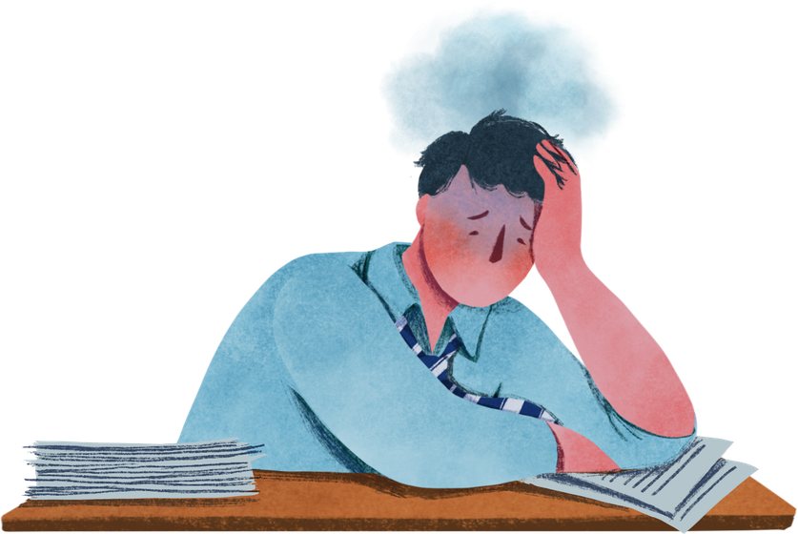
Methodology
The methodology selected for the correllation between both variables are given by the use of a survey where people will select their specific data and then it will be correlated.
The way the survey will be done is by answering questions daily to measure days when they feel bad emotionally and/or in terms of wanting to do something and days when they feel good and correlate them with their habits of sleeping, eating and use of technology

Slide 5
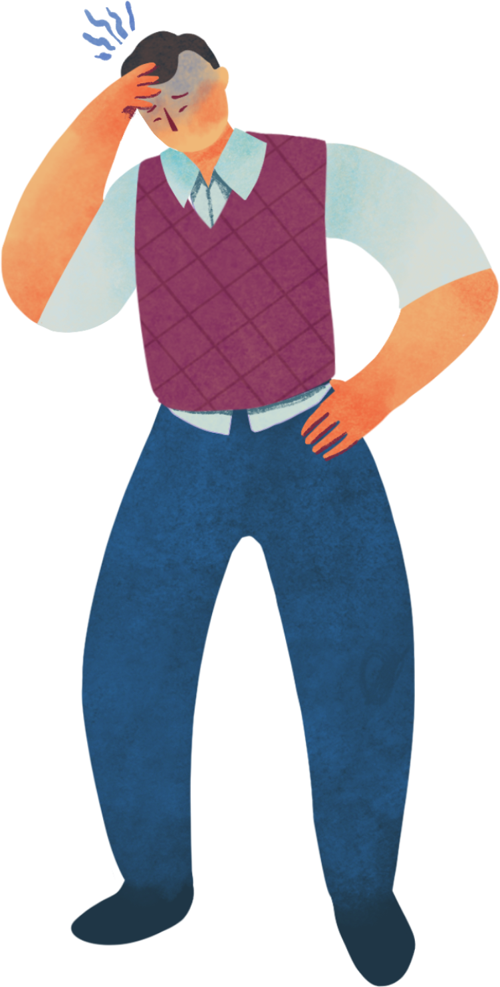
Project design
Approach
  Quantitative correlational study using a digital survey.
Objective
  Correlate daily behavioral habits with fluctuations in emotional well-being.
Survey Modules & Variables
  Sleep Habits: Total sleep time and perceived rest quality.
  Food Habits: Meal frequency and nutritional quality.
  Technology & AI: Screen time, AI application, and tech dependence.
  Emotional Well-being: General mood, motivation, and fatigue.

Slide 6

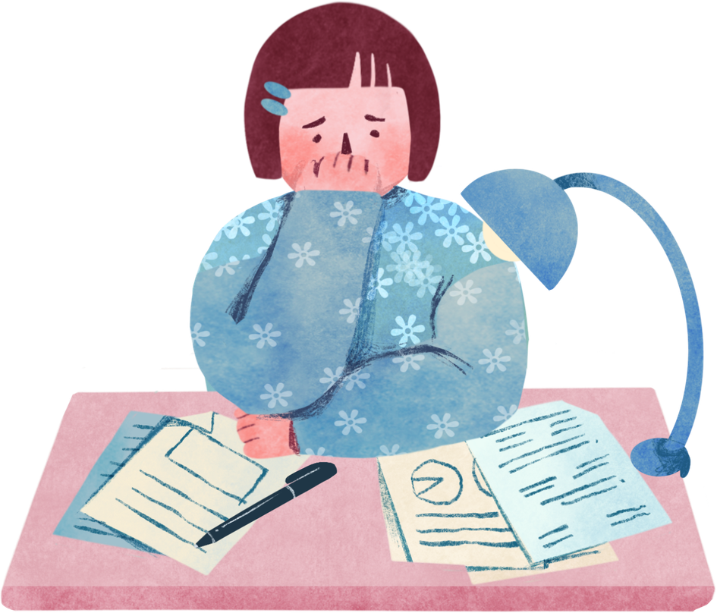
General data
1. What is your age?:
2. Sex:
3. Career on course:
4. Actual period:
5. Do you have a job?
6. Have you experience burnout or similar episodes before?
7. Do you go to psychiatric treatment?
8. Do you assist to psychological treatement?

Slide 7
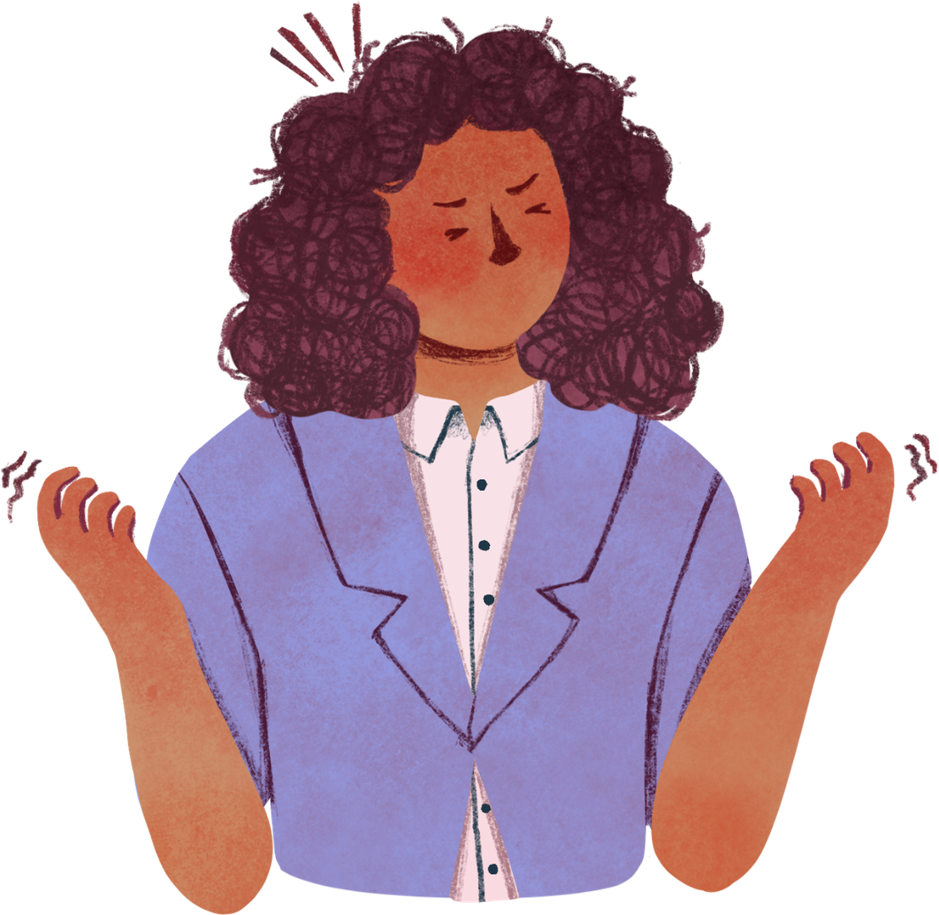
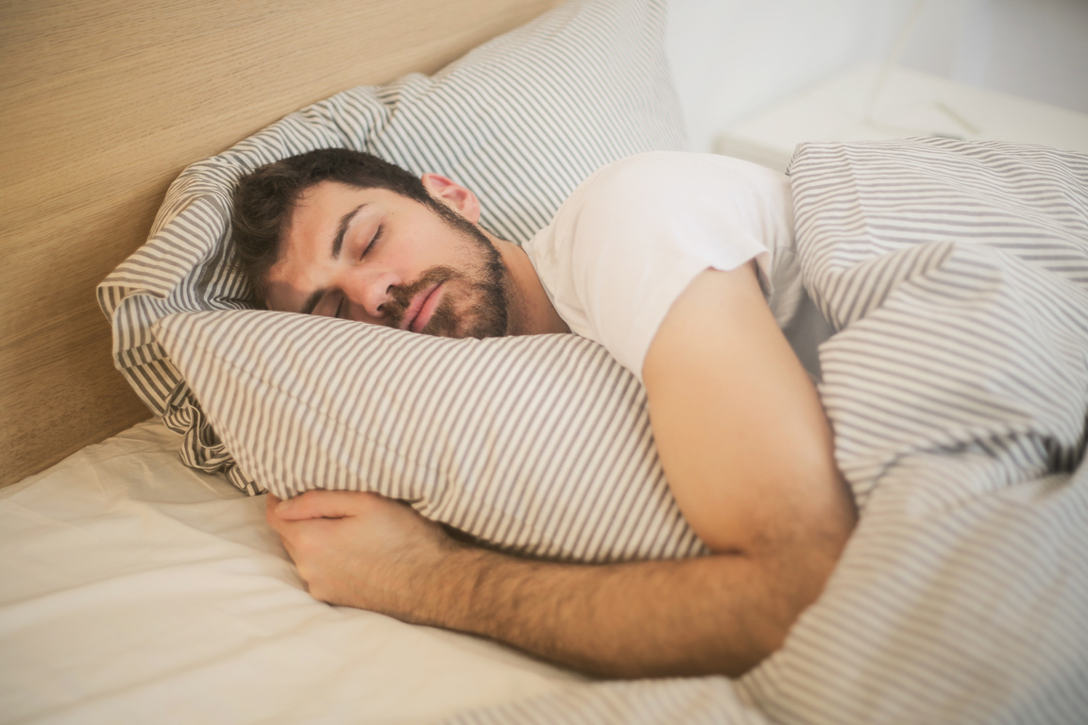
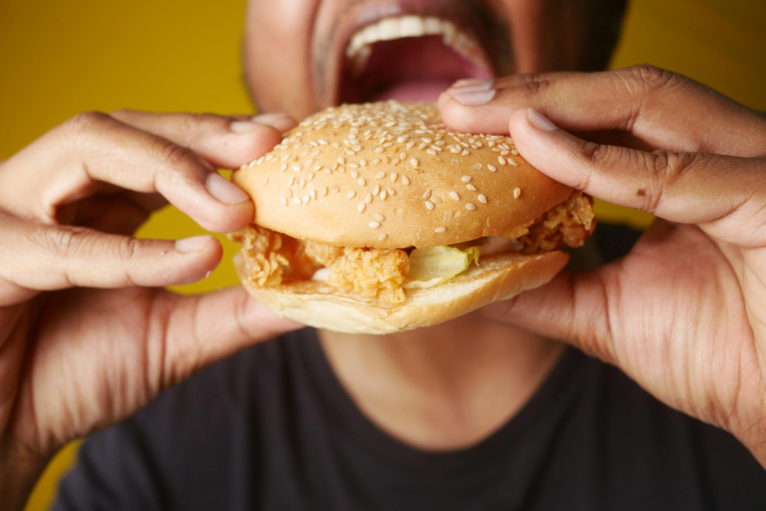


Main variables
Sleeping
  How many sleeping hours do you have?
  How would you qualify the sleeping quality?
Eating
  How many meals did you got today?
  How would you qualify your meals (in terms of feel good)?
Technology
  How many hours did you used technology of your free time?
  How would you qualify the tech quality usage?
  Did you use AI today?
  How did you use it?
General well-being
  How would you qualify your well-being of today?

Slide 8
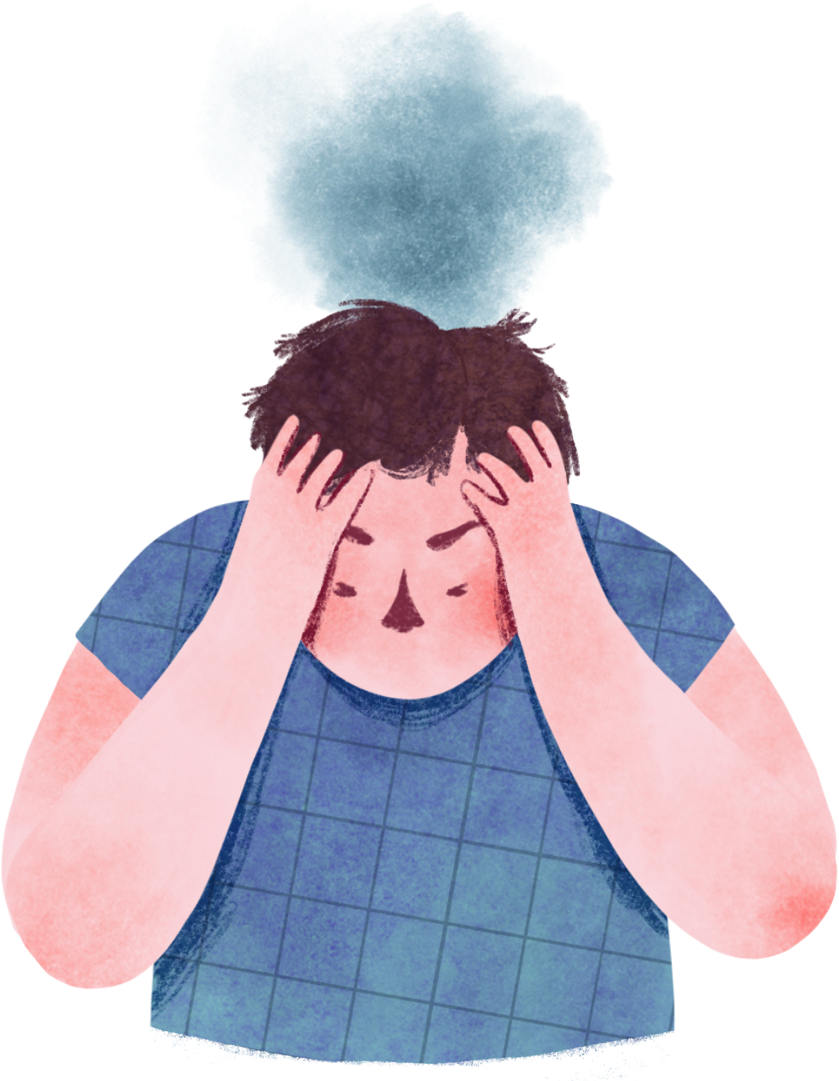

THANKS
Let us see your questions
Team members
Barraza Torres Jesús Daniel
Cardiel Mares Emiliano Arturo
Flores Hernández José Fernando
Rivera Leyva Sebastián
Rodríguez Sánchez Carlos Manuel

